Slide 1


Reading List – Hobby Web Application
Syed Zaidi

Slide 2
Introduction
Concept
An application with some functional use
A reading list application to keep track of the books you have read/are reading/plan to read
MVP
Full CRUD functionality
SQL local database
Intuitive/Visually pleasing Front End
Aiming for 80% coverage

Slide 3
Consultant Journey -Technologies Used
Git/Github
MySQL/H2
Java/Springboot (API)
HTML/CSS/JavaScript
Maven, Junit, Mockito
Kanban Board - Jirra

Slide 4
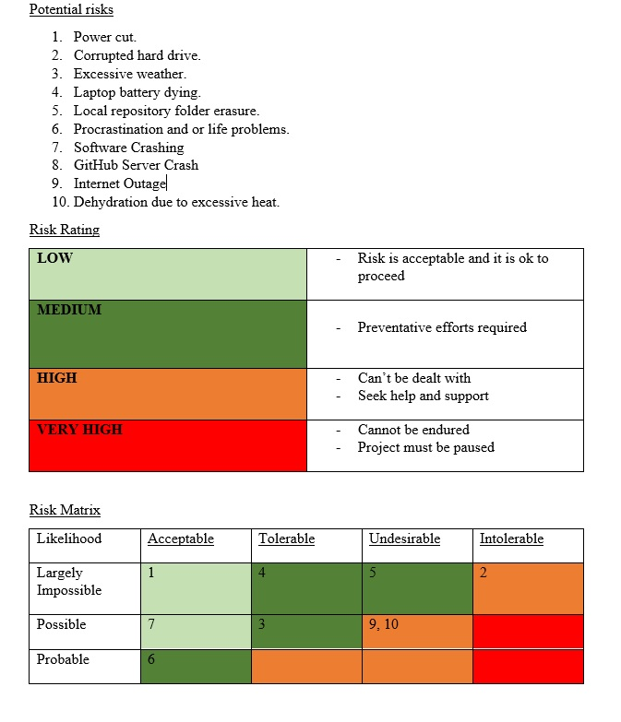
Risk Assessment
Internet Outage
- Call ISP to get back online ASAP
Slow Computer
Excessive weather/Heat

Slide 5
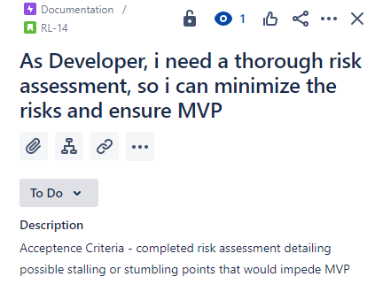
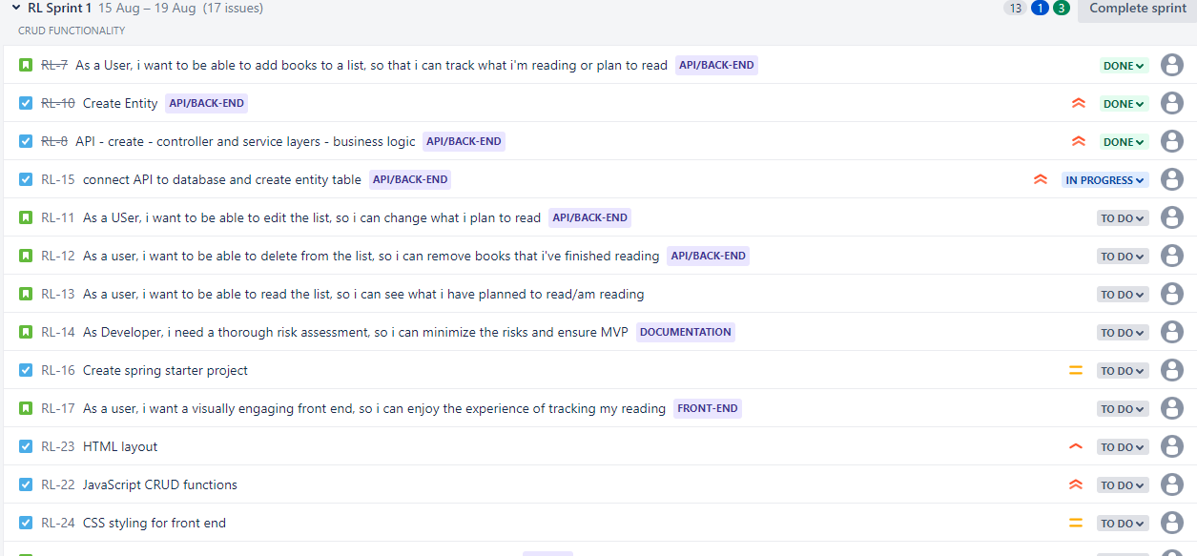
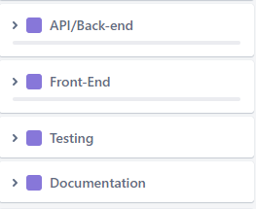
Sprint Plan
4 Epics
Single sprint – 3 days
Acceptance criteria/prioritisation

Slide 6
FBD - Continuous Integration
Git and Github – Version control
Main Branch
Development Branch
Feature branches
- API
- Testing
- Front End
-Documentation

Slide 7
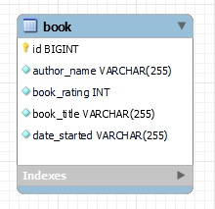
ERD
Book
Title
Author
Date Started
Rating

Slide 8
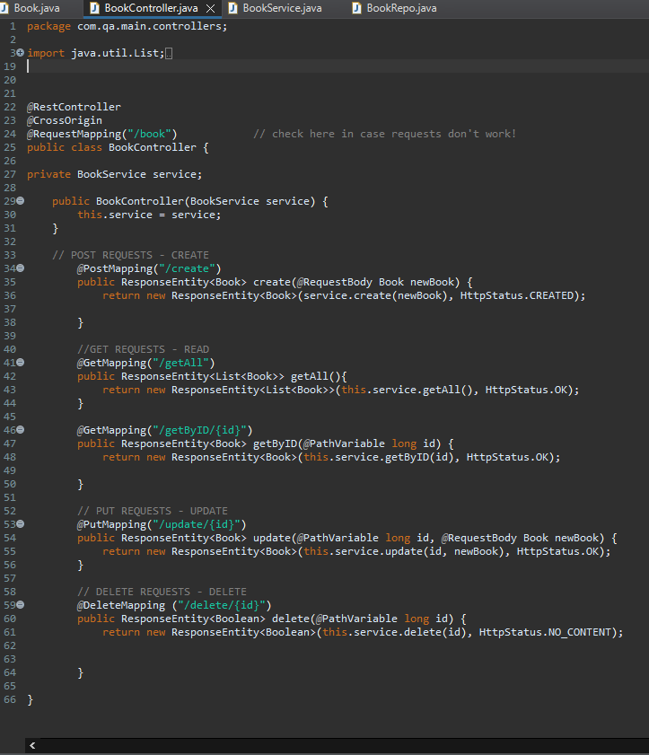
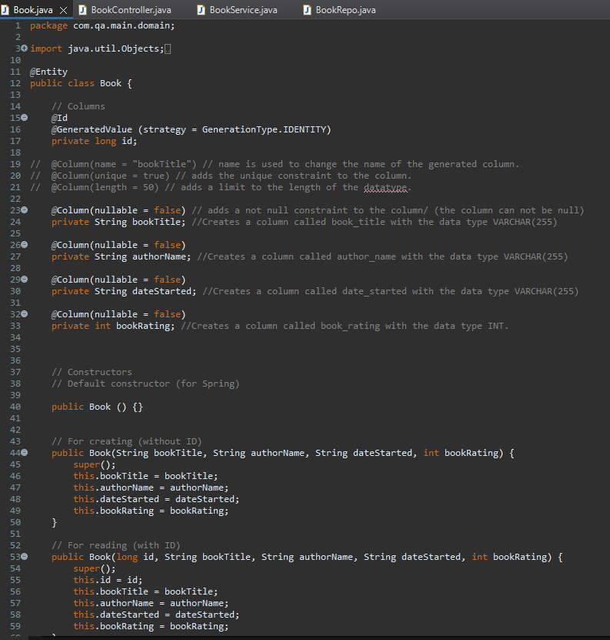
Building the API

Slide 9
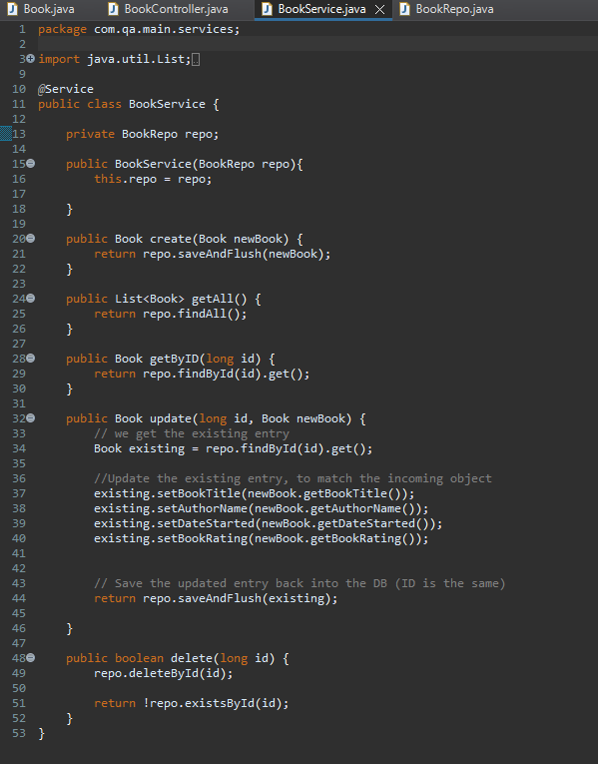
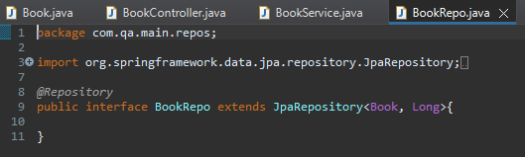
Building the API Cont.
API Layers
Entity – Book
Controller – Functions that call on the logic
Service – Business Logic
Repo

Slide 10
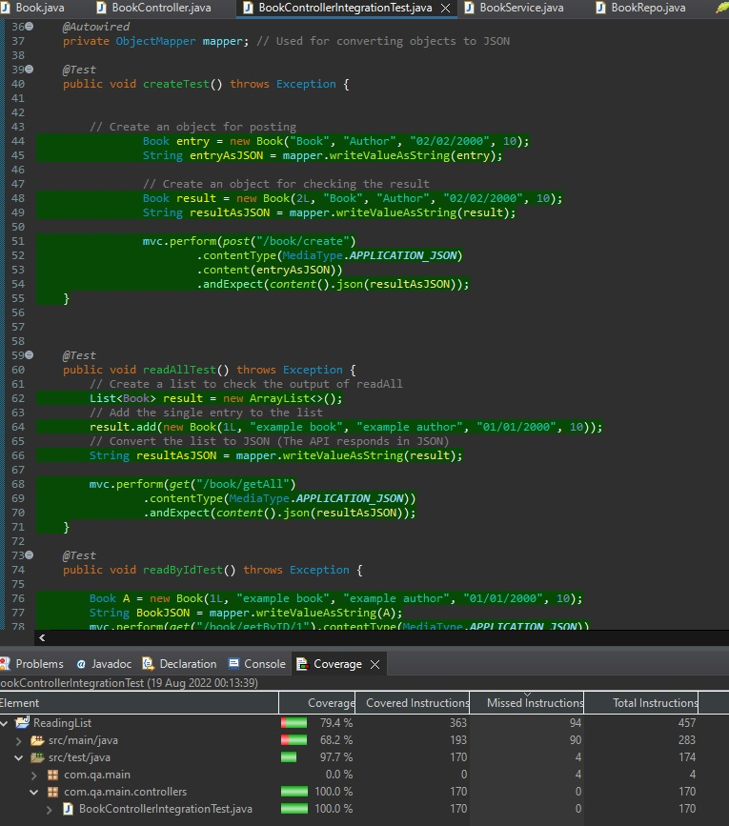
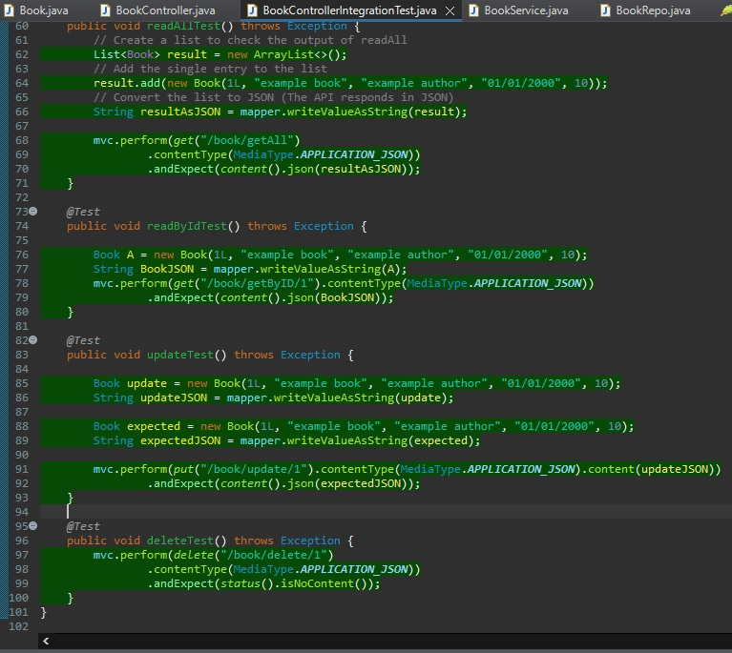
Testing
Integration and Unit Testing
Some errors initially – testdata/testschema

Slide 11
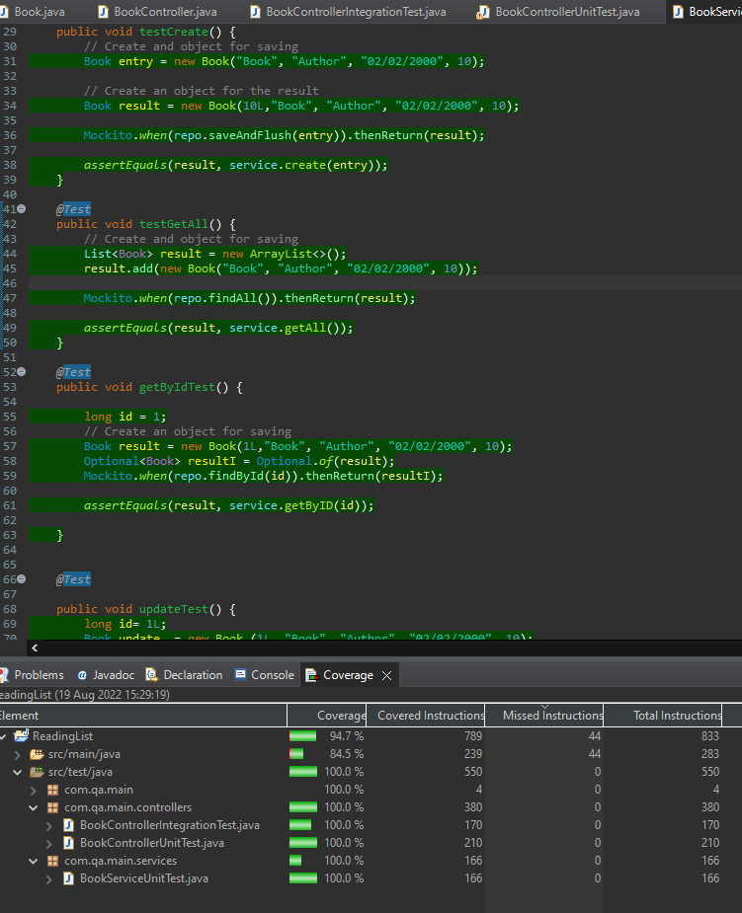
Unit Testing
Overall Project coverage – 94.7%

Slide 12
Demonstration

Slide 13
Sprint Review/Retrospective
In hindsight :-
Shorter sprints– compensate for risks
Break user stories down further into minutae
Achieved CRUD – However Front end visually could be more cohesive.
Greater variables - Page Number, Started reading/finished.

Slide 14
Thank You for listening!

